Slide 1


DARS
Data Analysts for your Recommender System

Slide 2
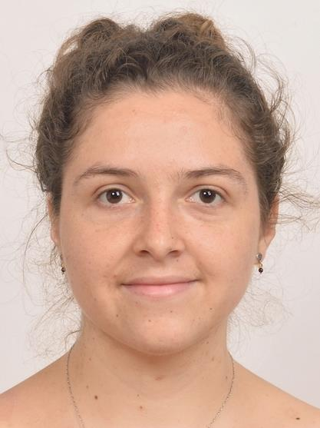
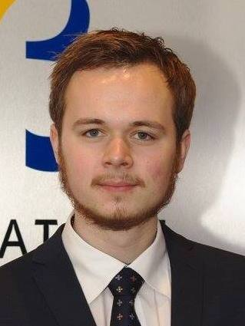

Sofia Vazquez Alferez
sofia.vazquezalferez@maastrichtuniversity.nl
Raphaël Morsomme
raphael.morsomme@maastrichtuniversity.nl

Slide 3

Content
The Project & what we’re doing
The Recommender System
Prototype
Contact details

Slide 4
1. The Project & What we’re doing

Slide 5
The Project
Started in September 2018
Recommender System for Students of
University College Maastricht (Liberal Arts and Sciences program)
Supporting Team:
Department of Knowledge Engineering, Maastricht University
Institute for Data Science, Maastricht University

Slide 6
GOAL
Help students make well-informed decisions with regard to course selection
Improve the self-advising process
To improve the information position of students with regard to their academic and professional interest, by complementing the work of academic advising and examination committee.

Slide 7
Stakeholders
Curriculum Development
Students
Academic Advisors

Slide 8
2. The Recommender System

Slide 9
Recommender System for Students
Topic Modelling
Sequential Pattern mining
LDA
CSPADE
Course Recommender System
output =
Course Recommendations
output =
Red Flags

Slide 10
Topic Modelling
Input Text
Course Manuals
Course Catalogue
Fit Topic Model
Number of topics (5 – 250)
Model Selection
Perplexity
Topic Profile of Student & Course Recommendation
Key words
LDA
Log Likelihood
Previous courses
Coherence

Slide 11
Sequence Mining
Input Transcripts
2014-2018
Apply CSPADE
Select Rules
Count > 20
Red flags
Confidence > 0.4
Lift > 1
if FAIL => FAIL
if NOT TAKEN => FAIL

Slide 12
3. Prototype

Slide 13
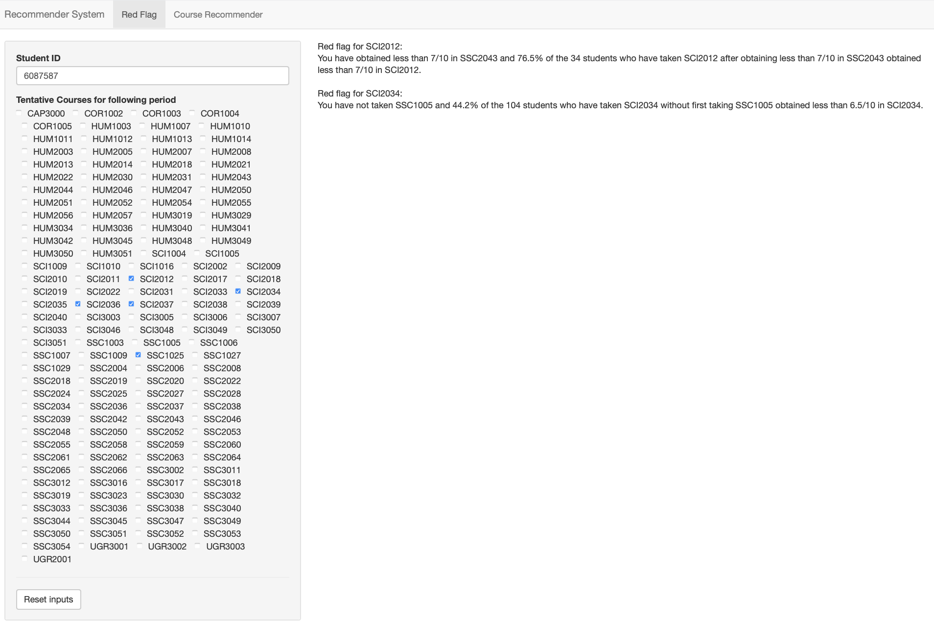

Slide 14
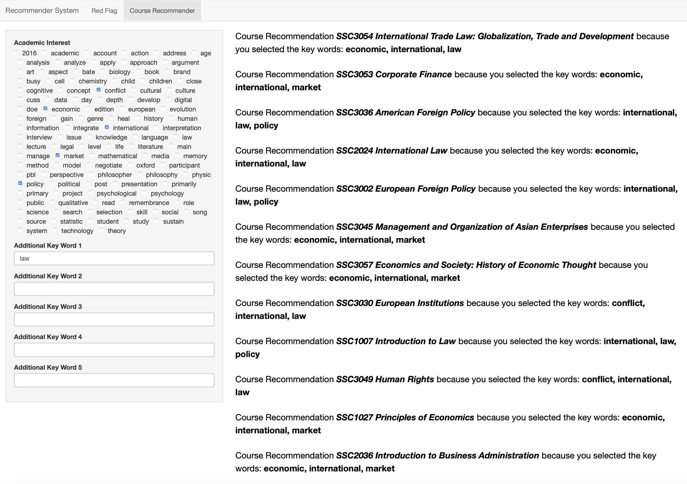

Slide 15
Contact:
Sofia Vazquez Alferez
sofia.vazquezalferez@maastrichtuniversity.nl
Raphaël Morsomme
raphael.morsomme@maastrichtuniversity.nl

